Slide 1

St. Joseph’s College
(AUTONOMOUS)
Tiruchirappalli – 620 002.

Slide 2


Slide 3
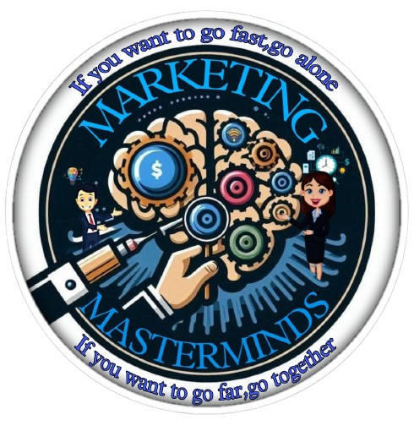
Marketing Masterminds
DIGITAL MARKETING
Lakshmi C 24PCC826
Anusha B 24PCC815
Roslin Jermiah A 24PCC828
Rishi S 24PCC837
SasiKumar M 24PCC844

Slide 4

Digital marketing refers to the promotion of products, services, or brands through digital channels, such as:-
Internet (websites, search engines, social media)
Mobile devices (SMS, MMS, apps)
Digital media (videos, podcasts, e-books)
Email
Online advertising (display ads, native ads)
Definition

Slide 5
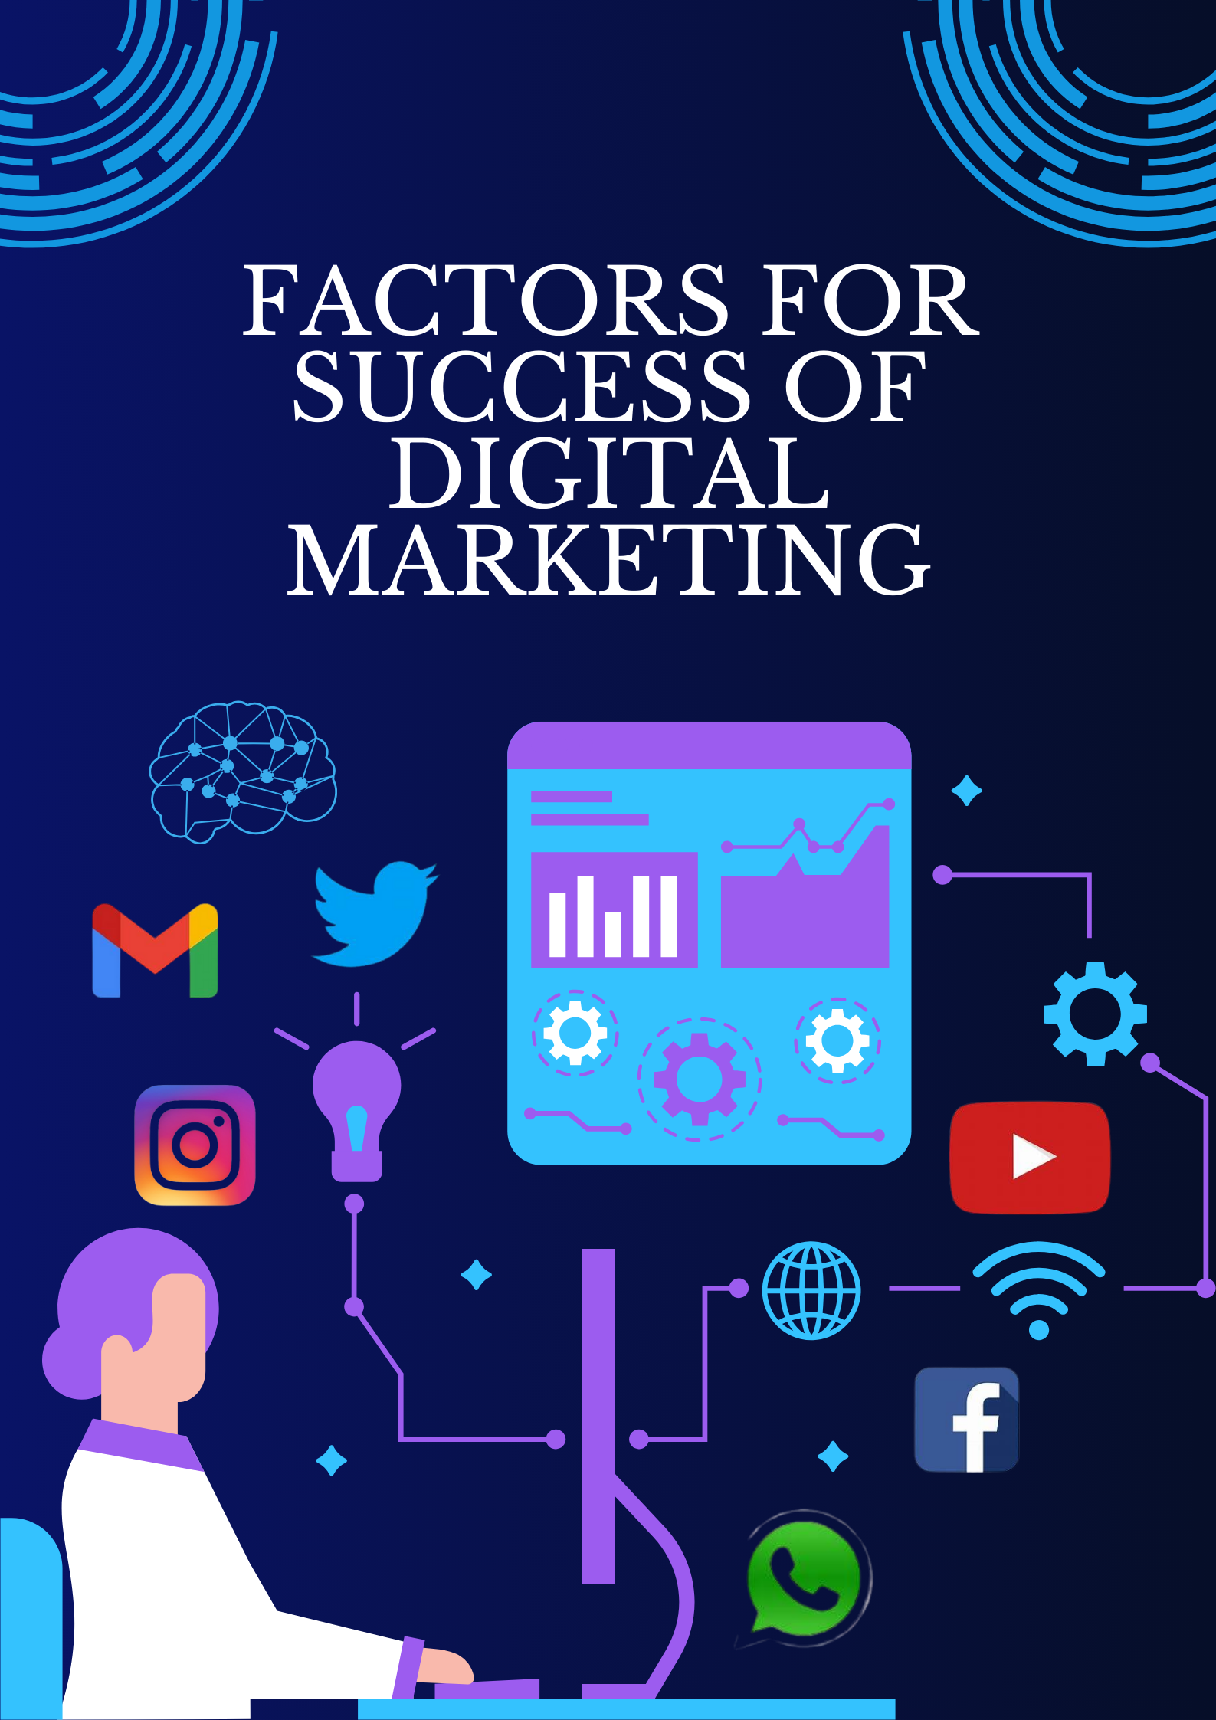

Slide 6
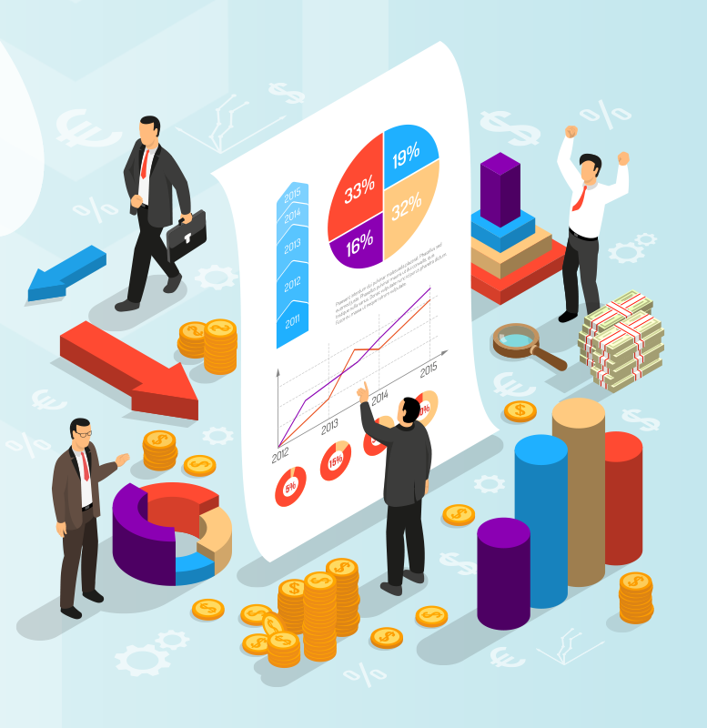
MEANING
Factors for success refer to the essential elements, conditions, or influences that contribute to achieving a desired outcome, goal, or objective in the context of digital marketing.

Slide 7
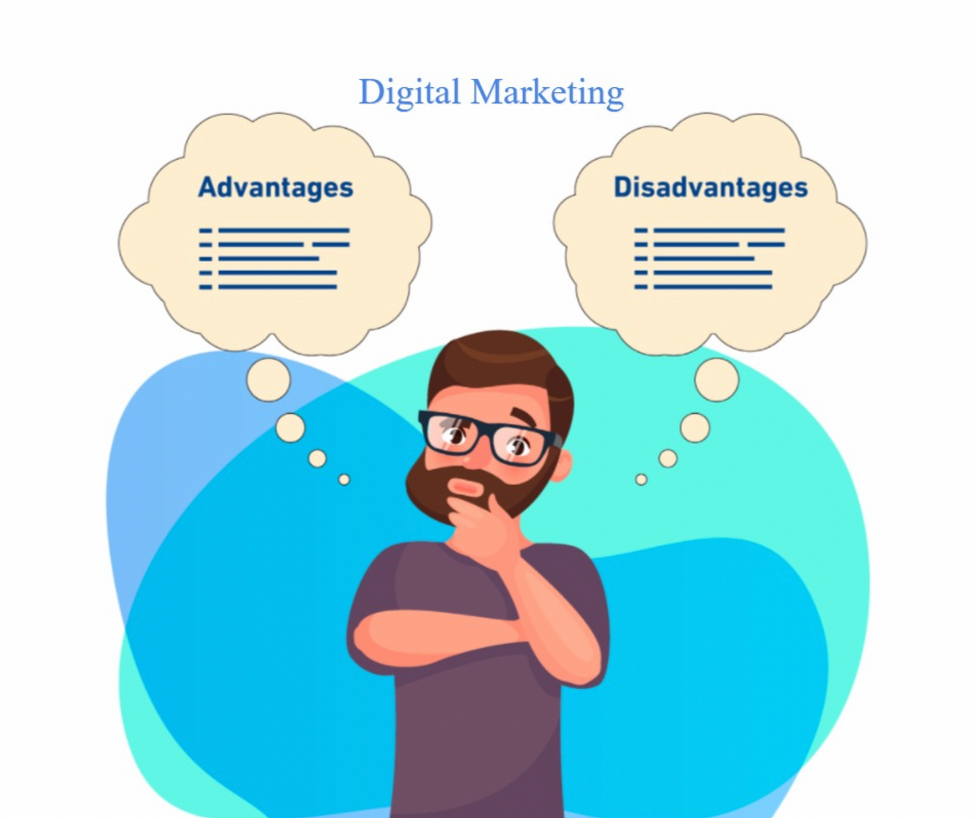
Advantages
Disadvantages
High Competition
Security & privacy Issues
Short Attention Span
Rapid Changes
Technology & Reliability
Skills & Training
Complaints & Feedback
Global Reach
Personalization
Brand Development
Greater Engagement
Increased ROI
Improved Customer Insights
Increased Brand Awareness

Slide 8

Factors For Success
CLEAR GOALS AND OBJECTIVES | EFFECTIVE WEBSITE & USER EXPERIENCE | E-MAIL MARKETING | DATA ANALYSIS AND MEASUREMENT | TEAM COLLABORATION & COMMUNICATION
SUCCESS

Slide 9
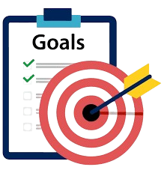
CLEAR GOALS AND OBJECTIVES
Direction and Focus.
Measurable Success.
Prioritization.
Alignment.
Motivation.
Accountability.
Data-Driven Decisions.
Optimization.

Slide 10

EFFECTIVE WEBSITE & USER EXPERIENCE
Clear Navigation.
Responsive Design.
Fast Loading Speed.
High-Quality Content.
Visual Appeal.
Mobile-Friendliness.
Easy Checkout Process.
Secure payment Options.
Regular Updates and Maintenance.

Slide 11
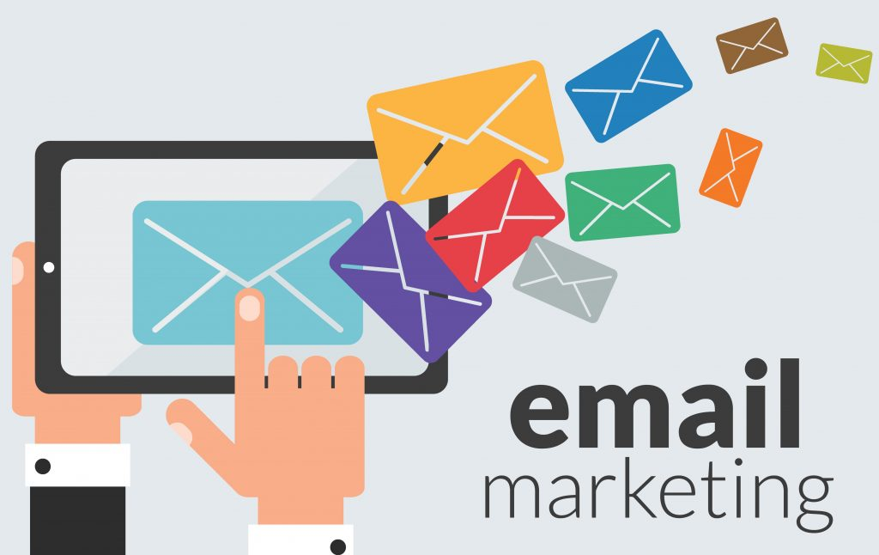
E-MAIL MARKETING
Build an email list and send targeted, personalized, and timely emails to nurture leads and customers.

Slide 12

DATA ANALYSIS AND MEASUREMENT
Track and analyze your digital marketing efforts to measure ROI and make data-driven decisions.

Slide 13

TEAM COLLABORATION & COMMUNICATION
Ensure effective communication and collaboration between teams, including marketing, sales, and customer service.

Slide 14
1. 2020: 70% (due to rapid digital adoption during the pandemic) 2. 2021: 75% (continued growth and refinement in strategies) 3. 2022: 80% (benefits from AI and machine learning) 4. 2023: 85% (emergence of new platforms and tools) 5. 2024: 90% (improved integration and focus on privacy)

Slide 15
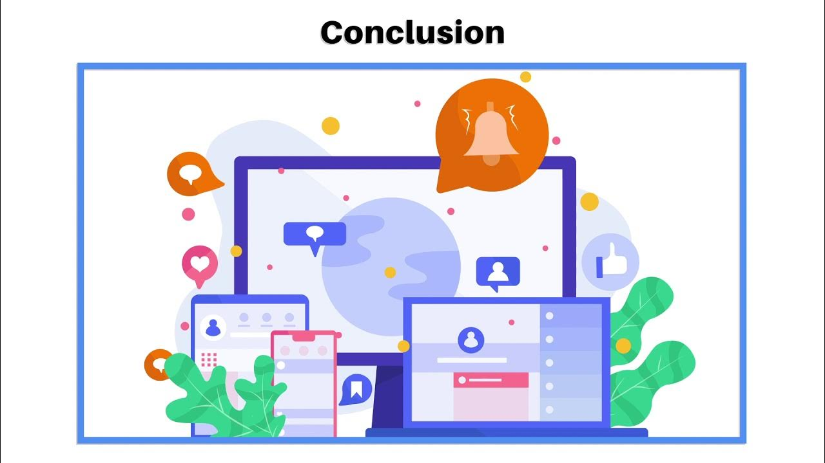
CONCLUSION
Digital marketing is the method of sales and promotion of a brand through digital media, particularly with the help of various tools available on the Internet.
Compared to traditional sales and marketing strategies it is more complex, omnipresent and efficient. This produces quicker positive results than traditional techniques, and is a more versatile form of marketing than conventional methods.

Slide 16


